Slide 1

More with SQL Select queries
SQL Select queries, part 02
Grouping data
Joining tables

Slide 2
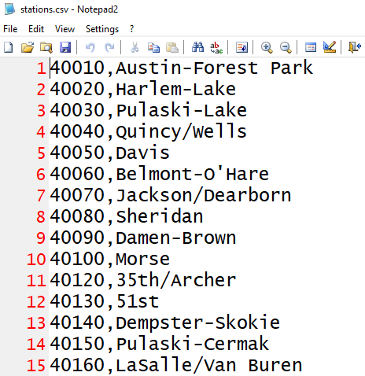
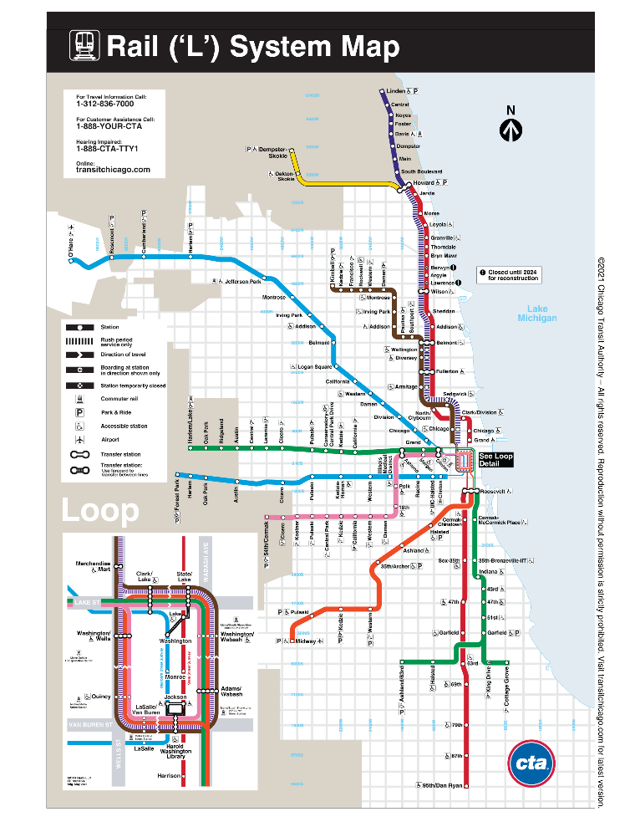
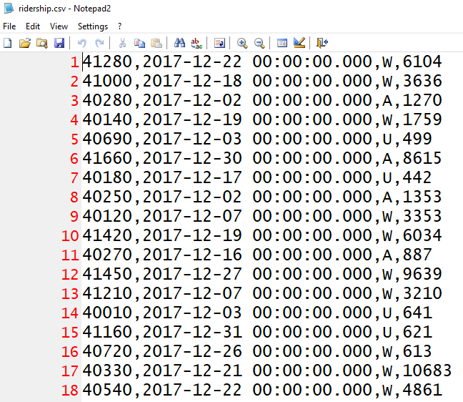
Database example: CTA
We have some CTA ridership data (L stations) that we need to analyze…

Slide 3
CTA database (subset)
Station_ID | Station_Name
40010 | Austin-Forest Park
40020 | Harlem-Lake
40030 | Pulaski-Lake
… | …
table: Stations
CTA.db
Station_ID | Ride_Date | Type_of_Day | Num_Riders
41280 | 2017-12-22 00:00:00.000 | W | 6104
40010 | 2017-12-28 00:00:00.000 | W | 1155
40280 | 2017-12-02 00:00:00.000 | A | 1270
40030 | 2017-12-24 00.00.00.000 | U | 595
… | … | … | …
table: Ridership

Slide 4
Group By and Having
Group by partitions the data into subsets
Functions then apply to the subsets
Where clause applies before grouping, Having applies after
SELECT <<the data you want>>
FROM <<table(s)>>
[ WHERE <<condition(s)>> ]
[ GROUP BY <<one or more fields>> ]
[ HAVING <<condition(s)>> ]
[ ORDER BY <<one or more fields>> ]
;

Slide 5
Example
Group By Ride_Date
Sum(Num_Riders)
Ride_Date
41280,12/22/2017,W,6104
41000,12/18/2017,W,3636
40280,12/02/2017,A,1270
40140,12/18/2017,W,1759
40690,12/03/2017,U,499
41660,12/03/2017,A,8615
40180,12/03/2017,U,442
40250,12/22/2017,A,1353
40120,12/07/2017,W,3353
41420,12/22/2017,W,6034
40270,12/18/2017,A,887
41450,12/18/2017,W,9639
41210,12/02/2017,W,3210
40010,12/22/2017,U,641
41160,12/22/2017,U,621
40720,12/18/2017,W,613
41280,12/22/2017,W,6104
40250,12/22/2017,A,1353
41420,12/22/2017,W,6034
40010,12/22/2017,U,641
41160,12/22/2017,U,621
14753
41000,12/18/2017,W,3636
40140,12/18/2017,W,1759
40270,12/18/2017,A,887
41450,12/18/2017,W,9639
40720,12/18/2017,W,613
16534
40280,12/02/2017,A,1270
41210,12/02/2017,W,3210
4480
40690,12/03/2017,U,499
41660,12/03/2017,A,8615
40180,12/03/2017,U,442
9556
40120,12/07/2017,W,3353
3353

Slide 6
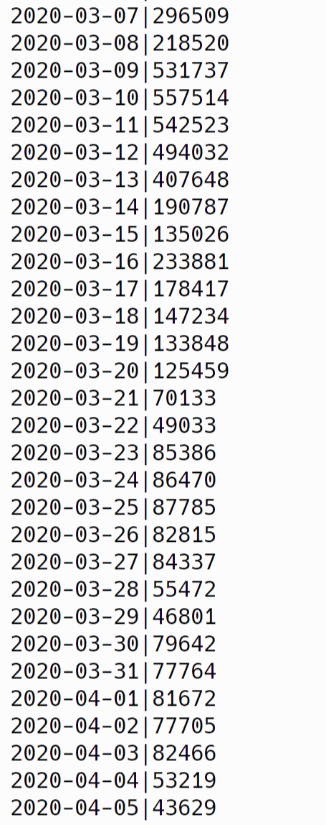
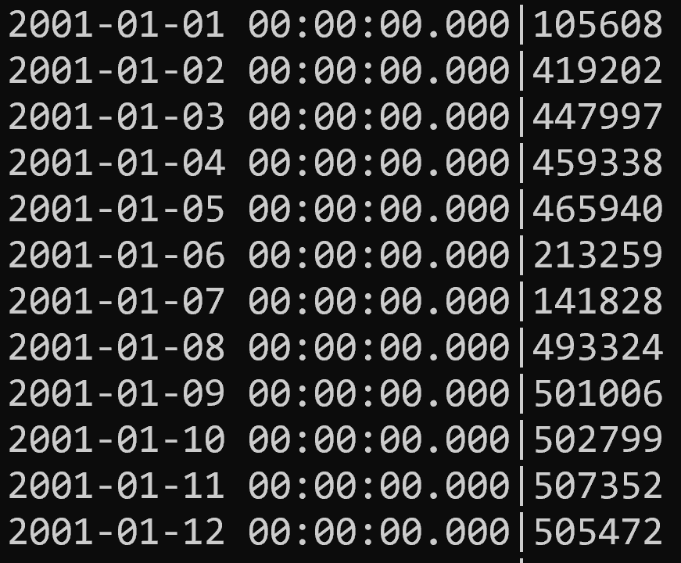
Example: riders per day
select Ride_Date, Sum(Num_Riders)
from Ridership
group by Ride_Date
order by Ride_Date ASC;

Slide 7
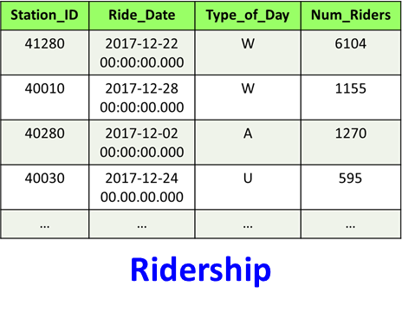
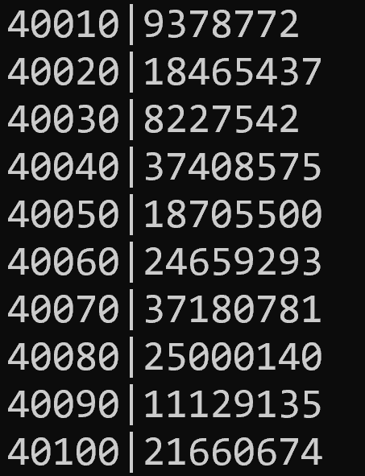
Question
What is the sum of ridership per station, on weekdays?
Hint: group by what?
select ?
from Ridership
where ?
group by ?
order by ?;

Slide 8
Query
select Station_ID, sum(Num_Riders)
from Ridership
where Type_of_Day = 'W'
group by Station_ID
order by Station_ID ASC;

Slide 9
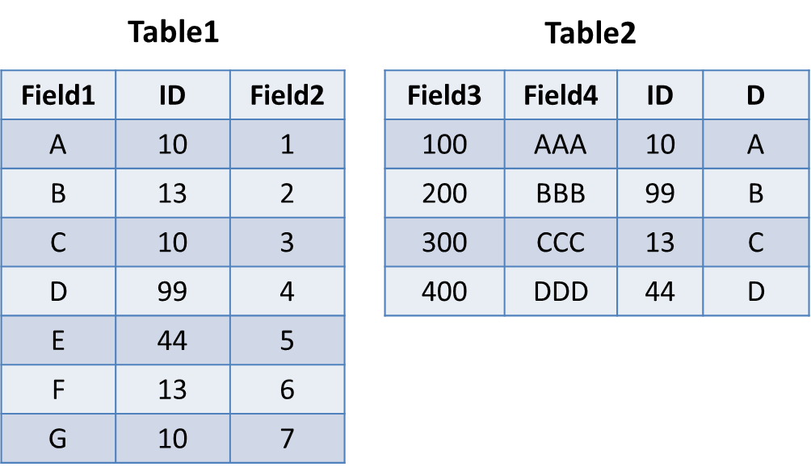
Consider the table… Let's look at the execution pipeline…
SELECT ID, Count(ID) AS Num
FROM Table1
WHERE 1 < Field2 AND Field2 < 7
GROUP BY ID
HAVING Num > 1
ORDER BY ID ASC;
10

Slide 10
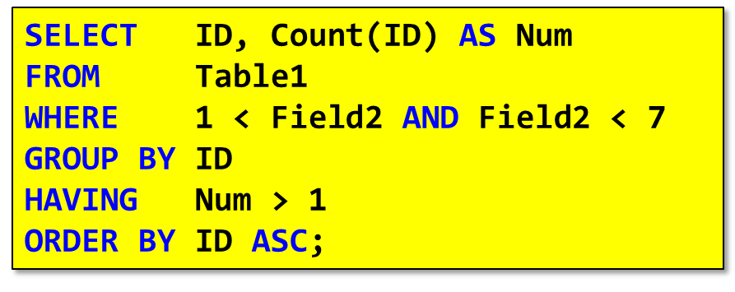
Execution
Field1 | ID | Field2
B | 13 | 2
C | 10 | 3
D | 99 | 4
E | 44 | 5
F | 13 | 6
Field1 | ID | Field2
B | 13 | 2
F | 13 | 6
C | 10 | 3
D | 99 | 4
E | 44 | 5
10
where()
groupby()
ID | Num
13 | 2
10 | 1
99 | 1
44 | 1
ID | Num
13 | 2
ID | Num
13 | 2
select()
having()
orderby()

Slide 11

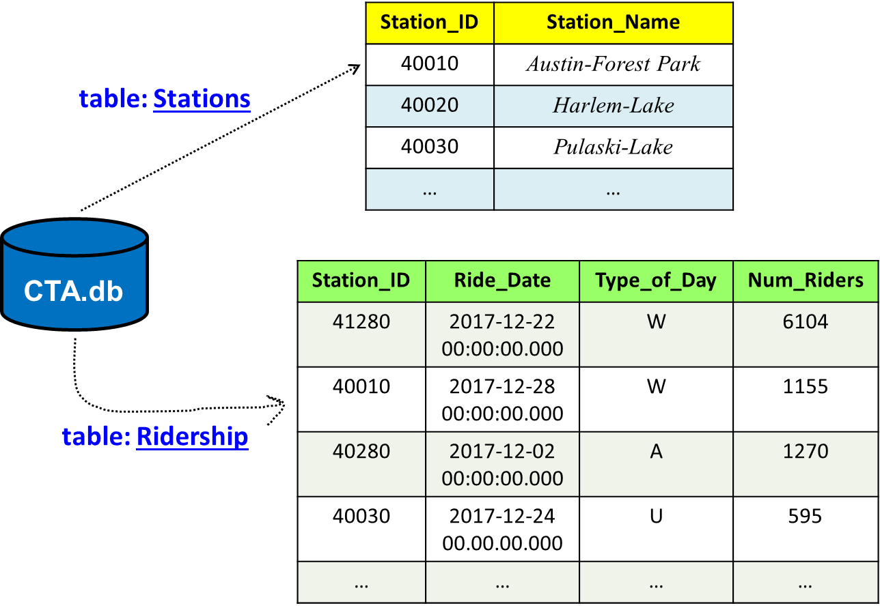
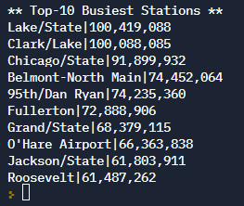
Joins
Joins are used to efficiently merge tables together
When we need data from both…
Example: we want top-10 stations in terms of ridership, with Name not Station ID…
Notes:
.open CTA.db
select "** Top-10 Busiest Stations **";
Select Station_Name, printf('%,d', Sum(Num_Riders))
From Ridership
Join Stations On Stations.Station_ID = Ridership.Station_ID
Group By Ridership.Station_ID
Order By Sum(Num_Riders) DESC
limit 10;

Slide 12
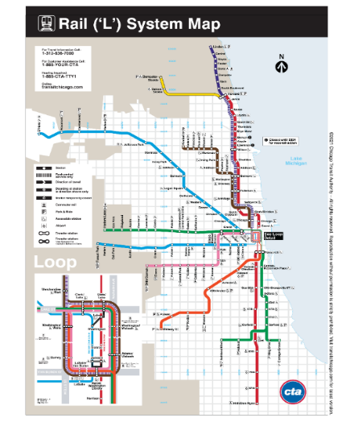
Top-10 Query
select "** Top-10 Busiest Stations **";
Select Station_Name, Sum(Num_Riders)
From Stations
Join Ridership On Stations.Station_ID = Ridership.Station_ID
Group By Stations.Station_ID
Order By Sum(Num_Riders) DESC
Limit 10;
Notes:
To get the commas in the output with SQLITE, you need to use printf, as in
Select Station_Name, printf('%,d', Sum(Num_Riders))

Slide 13
Join
SELECT <<the data you want>>
FROM <<table(s)>>
[ JOIN <<other table(s)>> ]
[ WHERE <<condition(s)>> ]
[ GROUP BY <<one or more fields>> ]
[ Having <<conditions(s)>> ]
[ ORDER BY <<one or more fields>> ]
;

Slide 14
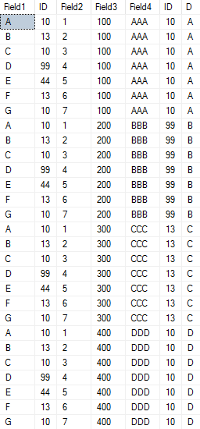
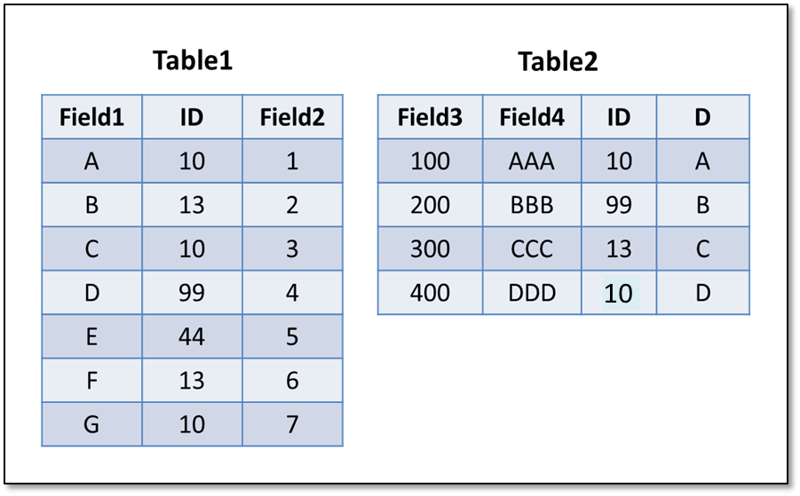
By default, join performs cartesian product
All possible combinations
i.e. combines each row in left table with each row in right table
SELECT *
FROM Table1
JOIN Table2;

Slide 15

SELECT *
FROM Table1
JOIN Table2;

Slide 16
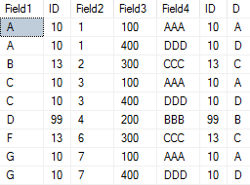
Join on condition
SELECT * FROM Table1
INNER JOIN Table2
ON Table1.ID = Table2.ID;
Join == Inner Join == intersection
Inner join => each row in left with matching row in right
Table1
Table2
Beware: sometimes you get multiple matches, or none
Notes:
Note that row with E disappears in the joined data…

Slide 17
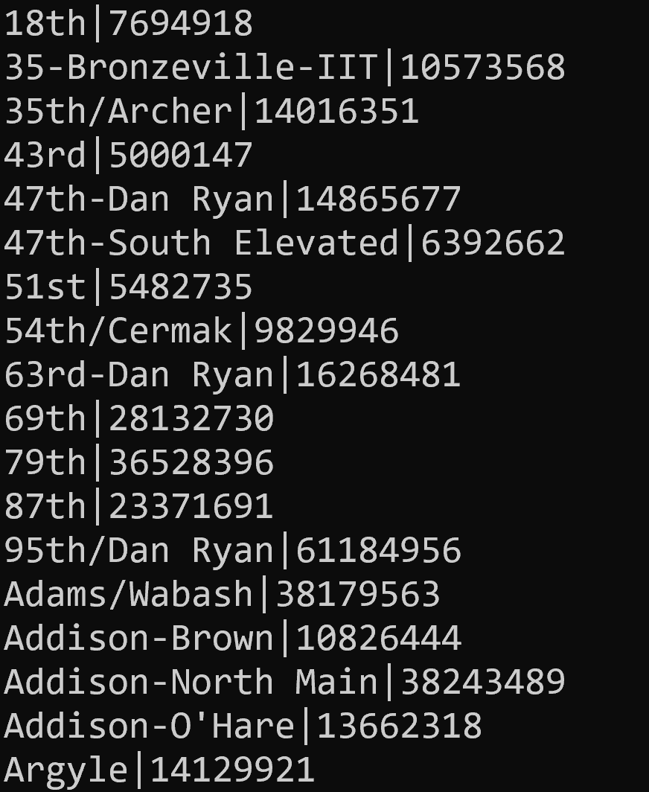
Example
What is the total # of riders through each station on weekdays, with station names not ids?
select Station_Name, Sum(Num_Riders)
from Ridership
inner join Stations on Stations.Station_ID = Ridership.Station_ID
where Type_of_Day = 'W'
group by Stations.Station_ID
order by Station_Name;

Slide 18

inner join => intersection
Notes:
Image Source: https://www.codeproject.com/Articles/33052/Visual-Representation-of-SQL-Joins

Slide 19
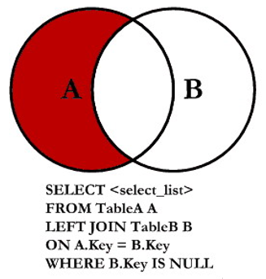
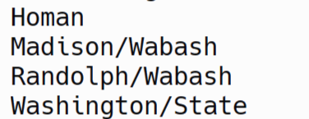
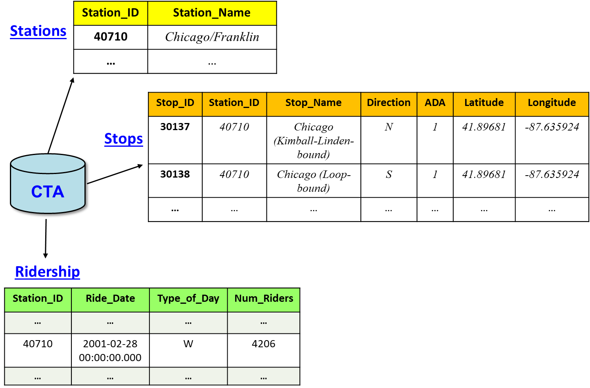
Question: which stations have no stops?
Select Station_Name
From Stations
Left Join Stops
On Stations.Station_ID = Stops.Station_ID
Where Stops.Station_ID IS NULL
Order by Station_Name;
Notes:
Select Station_Name
From Stations
Left Join Stops
On Stations.Station_ID = Stops.Station_ID
Where Stops.Station_ID IS NULL
Order by Station_Name;

Slide 20
That's it, thank you!

